Slide 1


ECO CAR Interview Presentation
By: Jonah Gandy

Slide 2
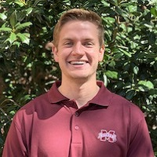

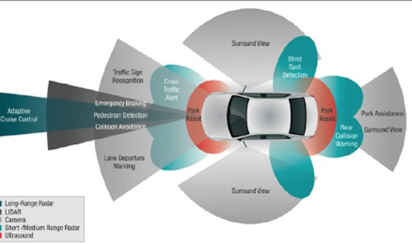
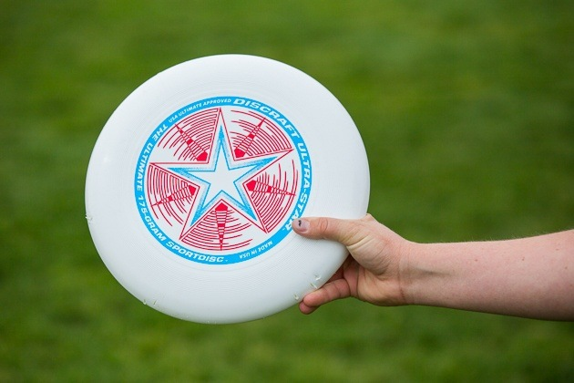

Introduction
Recent MSU Grad (May 2020)
Undergraduate in Computer Engineering
Pursing Masters Degree in ECE with a focus on Autonomous Systems
Hobbies and Interests
IoT devices (Raspberry Pi, ESP32)
Ultimate Frisbee
Autonomous Vehicles

Slide 3



The Problem
Sensor Fusion
Radar Sensor
CAN Bus
Radar Parser
/radar_data
Topic Listener
CAVS dbc file
File
ROS Node
Sensor on CAN Bus

Slide 4





Developing a Solution
Requirements
Test
Problem
Development
Solution

Slide 5

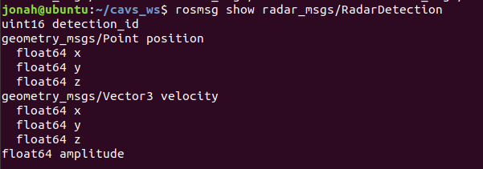
ROS Node
Import Libraries
Setup ROS Node
Extract CAN Signals
Setup CAN bus
Setup Radar Msg
Publishing Loop
Receive CAN Msg
Decode Message
Update & Publish

Slide 6
ROS Node
Import Libraries
Setup ROS Node
Extract CAN Signals
Setup CAN bus
Setup Radar Msg
Publishing Loop
Receive CAN Msg
Decode Message
Update & Publish

Slide 7
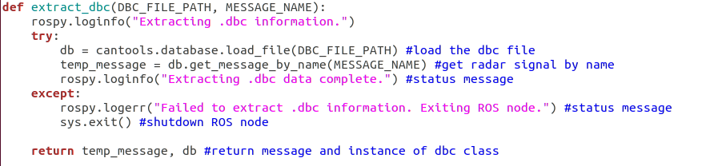
ROS Node
Import Libraries
Setup ROS Node
Extract CAN Signals
Setup CAN bus
Setup Radar Msg
Publishing Loop
Receive CAN Msg
Decode Message
Update & Publish

Slide 8
ROS Node
Import Libraries
Setup ROS Node
Extract CAN Signals
Setup CAN bus
Setup Radar Msg
Publishing Loop
Receive CAN Msg
Decode Message
Update & Publish

Slide 9
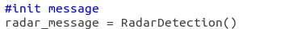
ROS Node
Import Libraries
Setup ROS Node
Extract CAN Signals
Setup CAN bus
Setup Radar Msg
Publishing Loop
Receive CAN Msg
Decode Message
Update & Publish

Slide 10
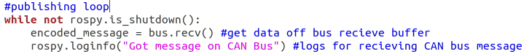
ROS Node
Import Libraries
Solutions for blocking function:
bus.recv(timeout=60)
Multithreaded approach
Setup ROS Node
Extract CAN Signals
Setup CAN bus
Setup Radar Msg
Publishing Loop
Receive CAN Msg
Decode Message
Update & Publish

Slide 11
ROS Node
Import Libraries
Setup ROS Node
Extract CAN Signals
Setup CAN bus
Setup Radar Msg
Publishing Loop
Receive CAN Msg
Decode Message
Update & Publish

Slide 12
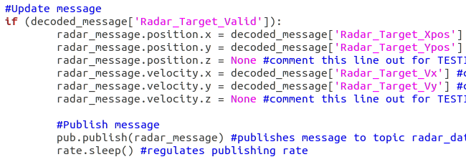
ROS Node
Import Libraries
Setup ROS Node
Extract CAN Signals
Setup CAN bus
Setup Radar Msg
Publishing Loop
Receive CAN Msg
Decode Message
Update & Publish

Slide 13
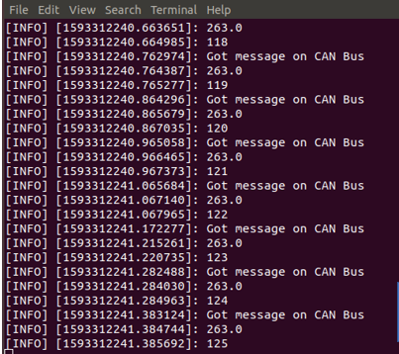
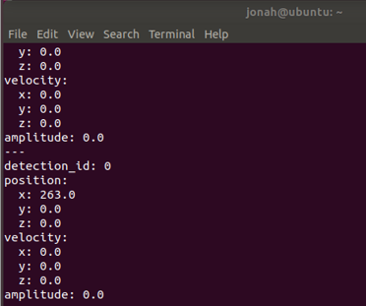
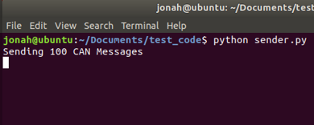
Testing: CAN Bus + ROS Node
CAN Bus Sending Program
Kvaser Virtual CAN Bus
ROS Node: /radar_parser
/radar_data
ROS Topic Listener

Slide 14
Multithreaded ROS Node (alternate approach)
Import Libraries
Setup Radar Msg
New Thread
Setup ROS Node
Extract CAN Signals
Extract CAN Signals
Setup CAN Bus
Setup CAN bus
Setup ROS Node
Publishing Loop
CAN Bus Loop
Read Radar Msg
Receive CAN Msg
Publish Message
Decode Message
Update Message

Slide 15






Documentation and Tools
GitHub: https://github.com/Jonahz1/CAVs_ROS_radar
Word Documentation
Primary Tools used for Development and Testing
Kvaser virtualcan drivers
Ubuntu
Python
Ros Melodic

Slide 16
Questions and Answers

Slide 17

Sources
[1] Electronics, C., 2020. CAN DBC File - Convert Data Live (Wireshark, J1939). [online] CSS Electronics. Available at: <https://www.csselectronics.com/screen/page/dbc-database-can-bus-conversion-wireshark-j1939-example/language/en> [Accessed 29 June 2020].
[2]"radar_msgs - ROS Wiki", Wiki.ros.org, 2020. [Online]. Available: http://wiki.ros.org/radar_msgs. [Accessed: 29- Jun- 2020].
[3] "astuff/astuff_sensor_msgs", GitHub, 2020. [Online]. Available: https://github.com/astuff/astuff_sensor_msgs/tree/melodic/radar_msgs. [Accessed: 29- Jun- 2020].
[4] "rospy_tutorials - ROS Wiki", Wiki.ros.org, 2020. [Online]. Available: http://wiki.ros.org/rospy_tutorials. [Accessed: 29- Jun- 2020].
[5] "CAN BUS tools — cantools 34.3.0 documentation", Cantools.readthedocs.io, 2020. [Online]. Available: https://cantools.readthedocs.io/en/latest/. [Accessed: 29- Jun- 2020].
[6] "python-can — python-can 3.3.3 documentation", Python-can.readthedocs.io, 2020. [Online]. Available: https://python-can.readthedocs.io/en/master/index.html. [Accessed: 29- Jun- 2020].
[7]"Linux Drivers and SDK", Kvaser, 2020. [Online]. Available: https://www.kvaser.com/linux-drivers-and-sdk/. [Accessed: 29- Jun- 2020].
[8] "Six rectangles progress PowerPoint Diagram Template", PowerPoint Templates, Diagrams and Charts for Free, 2020. [Online]. Available: https://www.free-powerpoint-templates-design.com/six-rectangles-progress-powerpoint-diagram-template/. [Accessed: 29- Jun- 2020].
[9]"LIDAR Gets the Green Light | MOTOR", MOTOR, 2020. [Online]. Available: https://www.motor.com/2019/06/lidar-gets-green-light/. [Accessed: 29- Jun- 2020].

Slide 18
Backup Slides

Slide 19
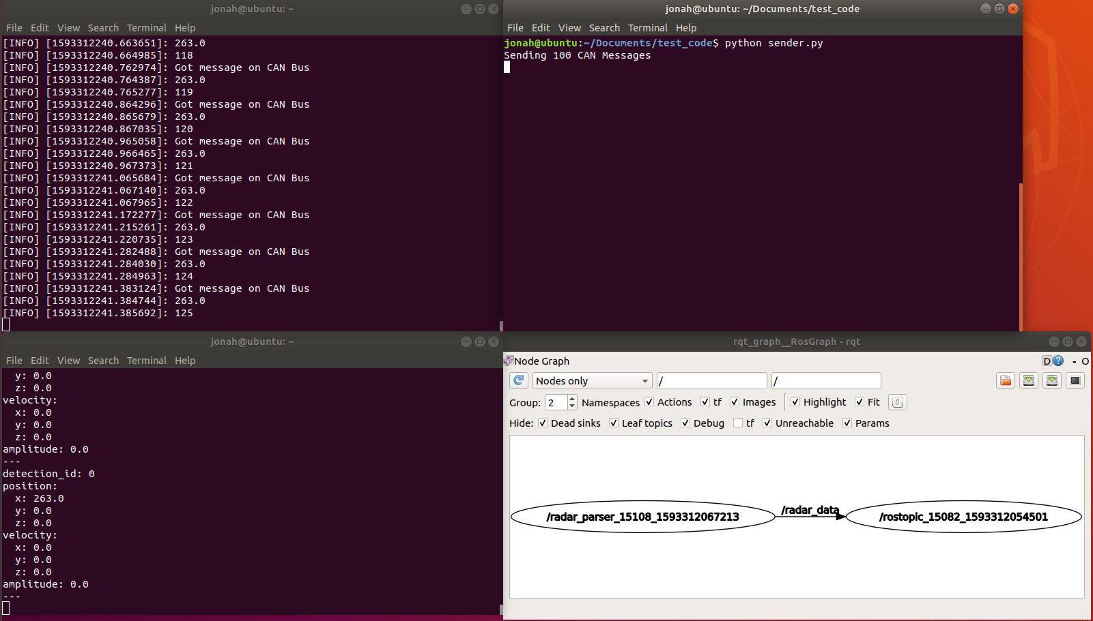
ROS node /radar_parser
Python test CAN Program
ROS topic /radar_data

Slide 20
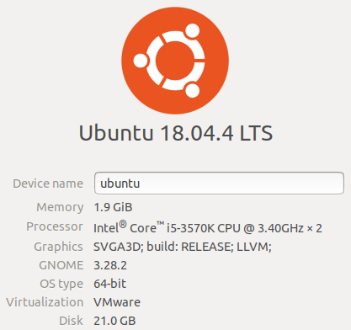

System Specifications
Linux Distribution: Ubuntu 18.04.4 LTS
Virtual Machine: VMware
ROS Melodic Morenia

Slide 21
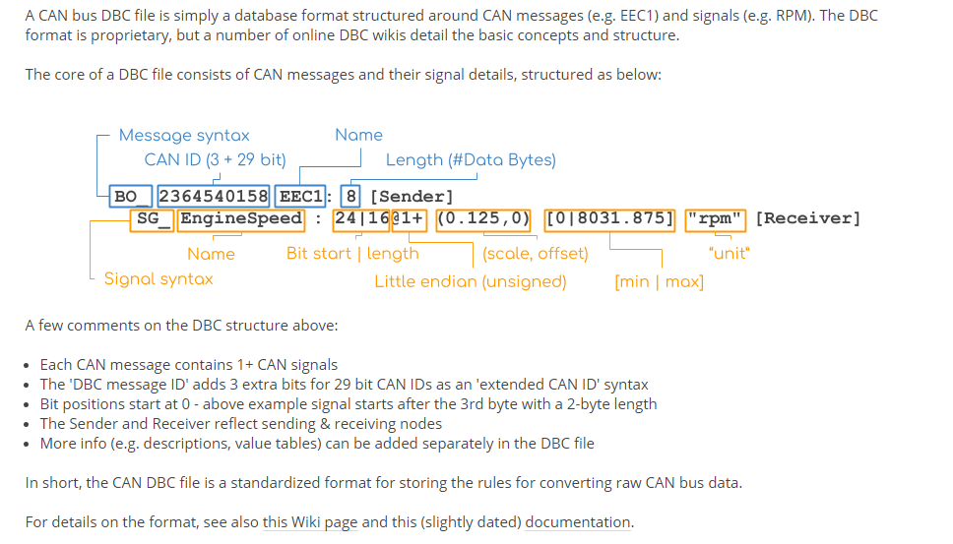
Understanding the .dbc file
https://www.csselectronics.com/screen/page/dbc-database-can-bus-conversion-wireshark-j1939-example/language/en

